Slide 1
ASP.NET - Life Cycle

Slide 2
Introduction
ASP.NET life cycle specifies, how:
ASP.NET processes pages to produce dynamic output
The application and its pages are instantiated and processed
ASP.NET compiles the pages dynamically.
What are the different events are which take place right from the time the user sends a request, until the time the request is rendered on the browser.

Slide 3
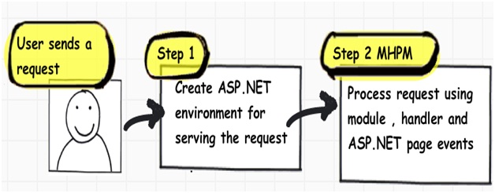
The Two Step Process
From 30,000 feet level, ASP.NET request processing is a 2 step process as shown below. User sends a request to the IIS:
Notes:
ASP.NET creates an environment which can process the request. In other words, it creates the application object, request, response and context objects to process the request.
Once the environment is created, the request is processed through a series of events which is processed by using modules, handlers, page objects and Module event (MHPM)

Slide 4
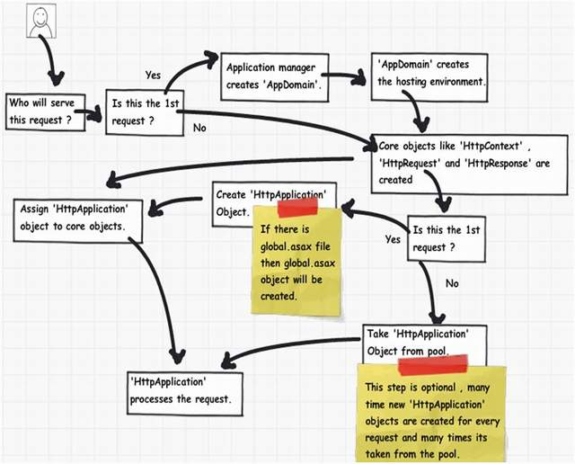
Creation of ASP.NET Environment
Notes:
the application domain creates isolation between two web applications hosted on the same IIS
‘HttpApplication’ object is created to serve the request.
HttpApplication instances might be reused for multiple requests.
HttpApplication then starts processing the request by HTTP module events, handlers and page events. It fires the MHPM event for request processing.

Slide 5
Detailed Steps
Step 1: The user sends a request to IIS. IIS first checks which ISAPI extension can serve this request. Depending on file extension the request is processed. For instance, if the page is an ‘.ASPX page’, then it will be passed to ‘aspnet_isapi.dll’ for processing.
Step 2: If this is the first request to the website, then a class called as ‘ApplicationManager’ creates an application domain where the website can run. As we all know, the application domain creates isolation between two web applications hosted on the same IIS. So in case there is an issue in one app domain, it does not affect the other app domain.
Step 3: The newly created application domain creates hosting environment, i.e. the ‘HttpRuntime’ object. Once the hosting environment is created, the necessary core ASP.NET objects like ‘HttpContext’ , ‘HttpRequest’ and ‘HttpResponse’ objects are created.
Step 4: Once all the core ASP.NET objects are created, ‘HttpApplication’ object is created to serve the request. In case you have a ‘global.asax’ file in your system, then the object of the ‘global.asax’ file will be created. Please note global.asax file inherits from ‘HttpApplication’ class.
Note: The first time an ASP.NET page is attached to an application, a new instance of ‘HttpApplication’ is created. Said and done to maximize performance, HttpApplication instances might be reused for multiple requests.
Step 5: The HttpApplication object is then assigned to the core ASP.NET objects to process the page.
Step 6: HttpApplication then starts processing the request by HTTP module events, handlers and page events. It fires the MHPM event for request processing.

Slide 6
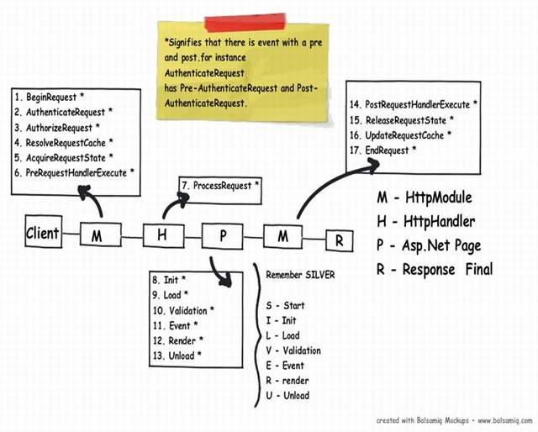
Process Request using MHPM Events Fired
Notes:
Once ‘HttpApplication’ is created, it starts processing requests. It goes through 3 different sections ‘HttpModule’ , ‘Page’ and ‘HttpHandler’.
If you want to inject logic based in file extensions like ‘.ASPX’, ‘.HTML’, then you use ‘HttpHandler’.
If you want to inject logic in the events of ASP.NET pipleline, then you use ‘HttpModule’.
M - Before the ASP.NET engine goes and creates the ASP.NET HttpModule. Before page object is created.
H - Once the above 6 events are fired, ASP.NET engine will invoke ProcessRequest
P - Once the HttpHandler logic executes, the ASP.NET page object is created. While the ASP.NET page object is created, many events are fired which can help us to write our custom logic inside those page events
M - Once the page object is executed and unloaded from memory, events which can be used to inject custom post-processing logic

Slide 7
More Details
Step 1(M: HttpModule): Client request processing starts. Before the ASP.NET engine goes and creates the ASP.NET HttpModule emits events which can be used to inject customized logic. There are 6 important events which you can utilize before your page object is created BeginRequest, AuthenticateRequest, AuthorizeRequest, ResolveRequestCache, AcquireRequestState and PreRequestHandlerExecute.
Step 2 (H: ‘HttpHandler’): Once the above 6 events are fired, ASP.NET engine will invoke ProcessRequest event if you have implemented HttpHandler in your project.
Step 3 (P: ASP.NET page): Once the HttpHandler logic executes, the ASP.NET page object is created. While the ASP.NET page object is created, many events are fired which can help us to write our custom logic inside those page events. There are 6 important events which provides us placeholder to write logic inside ASP.NET pages Init, Load, validate, event, render and unload. You can remember the word SILVER to remember the events S – Start (does not signify anything as such just forms the word) , I – (Init) , L (Load) , V (Validate), E (Event) and R (Render).
Step4 (M: HttpModule): Once the page object is executed and unloaded from memory, HttpModule provides post page execution events which can be used to inject custom post-processing logic. There are 4 important post-processing events PostRequestHandlerExecute, ReleaserequestState, UpdateRequestCache and EndRequest.

Slide 8
Section | Event | Description
HttpModule | BeginRequest | This event signals a new request; it is guaranteed to be raised on each request.
HttpModule | AuthenticateRequest | This event signals that ASP.NET runtime is ready to authenticate the user. Any authentication code can be injected here.
HttpModule | AuthorizeRequest | This event signals that ASP.NET runtime is ready to authorize the user. Any authorization code can be injected here.
HttpModule | ResolveRequestCache | In ASP.NET, we normally use outputcache directive to do caching. In this event, ASP.NET runtime determines if the page can be served from the cache rather than loading the patch from scratch. Any caching specific activity can be injected here.
HttpModule | AcquireRequestState | This event signals that ASP.NET runtime is ready to acquire session variables. Any processing you would like to do on session variables.
HttpModule | PreRequestHandlerExecute | This event is raised just prior to handling control to the HttpHandler. Before you want the control to be handed over to the handler any pre-processing you would like to do.
HttpHandler | ProcessRequest | Httphandler logic is executed. In this section, we will write logic which needs to be executed as per page extensions.
Page | Init | This event happens in the ASP.NET page and can be used for:Creating controls dynamically, in case you have controls to be created on runtime. Any setting initialization. Master pages and the settings. In this section, we do not have access to viewstate, postedvalues and neither the controls are initialized.
Page | Load | In this section, the ASP.NET controls are fully loaded and you write UI manipulation logic or any other logic over here.
Page | Validate | If you have valuators on your page, you would like to check the same here.
 | Render | It’s now time to send the output to the browser. If you would like to make some changes to the final HTML which is going out to the browser, you can enter your HTML logic here.
Page | Unload | Page object is unloaded from the memory.
HttpModule | PostRequestHandlerExecute | Any logic you would like to inject after the handlers are executed.
HttpModule | ReleaserequestState | If you would like to save update some state variables like session variables.
HttpModule | UpdateRequestCache | Before you end, if you want to update your cache.
HttpModule | EndRequest | This is the last stage before your output is sent to the client browser.

